Slide 1

Your first Elm program
Briefly about Elm
Jump in and swim
An app on GitHub pages
Per Lundholm Crisp

Slide 2
Survey
How many consider themselves
Developers?
Front end developers?
Back end developers?
Full stack developers?

Slide 3
What happened?
I was happily doing server side rendered web pages with some Ajax
Then, one day I was no longer a developer, I was a backend developer
I decided to learn some JavaScript to get back into doing the whole thing

Slide 4
JavaScript – what are thou?
Meteor
Angular
React
React Native
NativeScript

Slide 5

Elm for the rescue
A pure functional language for the web
Compiles to JavaScript
On the box it says:
No runtime errors in practice. No null. No undefined is not a function.
Friendly error messages that help you add features more quickly.
Well-architected code that stays well-architected as your app grows.
Automatically enforced semantic versioning for all Elm packages.

Slide 6
Personally, I like
After hobby hacking and full time for 5 months:
Type safe to the bone, yet lean
No null, instead Maybe and handle both cases
No exceptions
No switch without handling all cases
When it compiles, it works – in runtime!
Refactoring guided by the compiler
All state in on place, not scattered about in components
Nice pattern for model, view and update
Small footprint
Fast

Slide 7
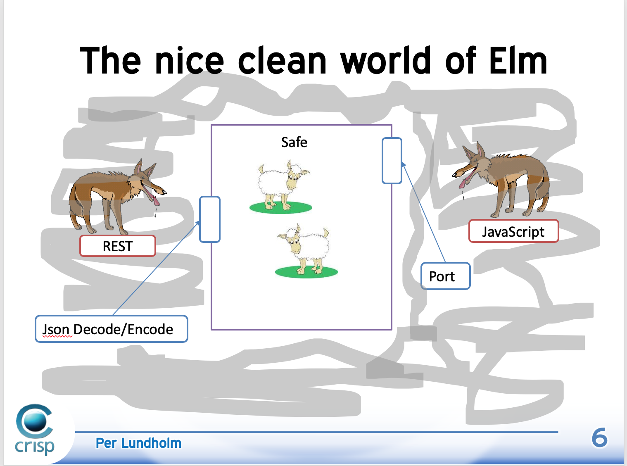

Slide 8
Why is type safe good?
How do you ensure program correctness?
By tests
What tests should you write to achieve above?
By sending a range of different input and check the result
So the bigger the range, the more tests?
Yes
What should you program do when the input is illegal?
Throw exception, return null or a status code.

Slide 9
Not so type safe Java
The domain of the parameter is maxed out
How do you write tests for that?
How does it effects the client of this method?

Slide 10
A bit better Java
ENOUGH!
The parameter need not be a Person

Slide 11
Let’s do Elm!
Like most language Elm has
Strings
“Agile means good”
Numbers
2 is an integer and 3.14 is a float
Lists
[“all”, “has” “to be”, “same”, “type” ]
Tuples
(“left”, “right”)

Slide 12


Elm Records
Please note the syntax for creating a new record based on the current

Slide 13
Elm modules
Modules
A module encapsulates its functions and types unless they are exposed (made public)
Access other modules by import.

Slide 14
Elm functions
Functions
A function will always return the same result for a given input.
Getting the time of day or generating a random number are not functions.

Slide 15
Structure of an Elm app
Model
The one and only for the whole app across all your pages.
View
The view is a function that takes the model and presents it.
If user can interact with something, it will result in a Message
Update
Takes a Message and the Model.
Creates the next state of the Model.

Slide 16
Get wet

Slide 17
Mission: Tic-tac-toe
Game of Tic-tac-toe
2 players
A grid of 3x3
Each player in turn places their marker on the grid
Markers are X and O, respectively
Objective is to have 3 in a row, column or diagonally

Slide 18
Step 0
Clone the workshop source
git clone https://github.com/crispab/elm-workshop
Clone your GitHub pages
git clone https://github.com/<username>/<username>.github.io
Clone your project repository
git clone https://github.com/<username>/<project-repository>
cd <project-repository>
elm in
cp ../elm-workshop/index.html .
cp ../elm-workshop/src/Main.elm src
cp ../elm-workshop/*.sh .
sh run.sh

Slide 19
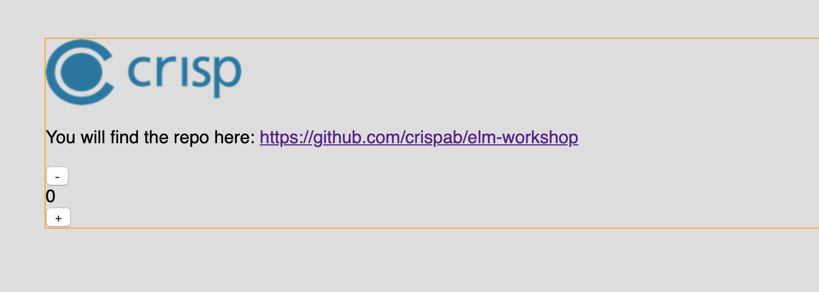
http://localhost:8000

Slide 20
Epilogue
Official guide: https://guide.elm-lang.org/
Example projects that requires no backend
The dice game of the book “The Goal” by Goldrath
Show lead time and throughput
Text based adventure game
The original from the 70’s is available
Loan calculator
How much can you borrow given interest and expenses?

